Slide 1

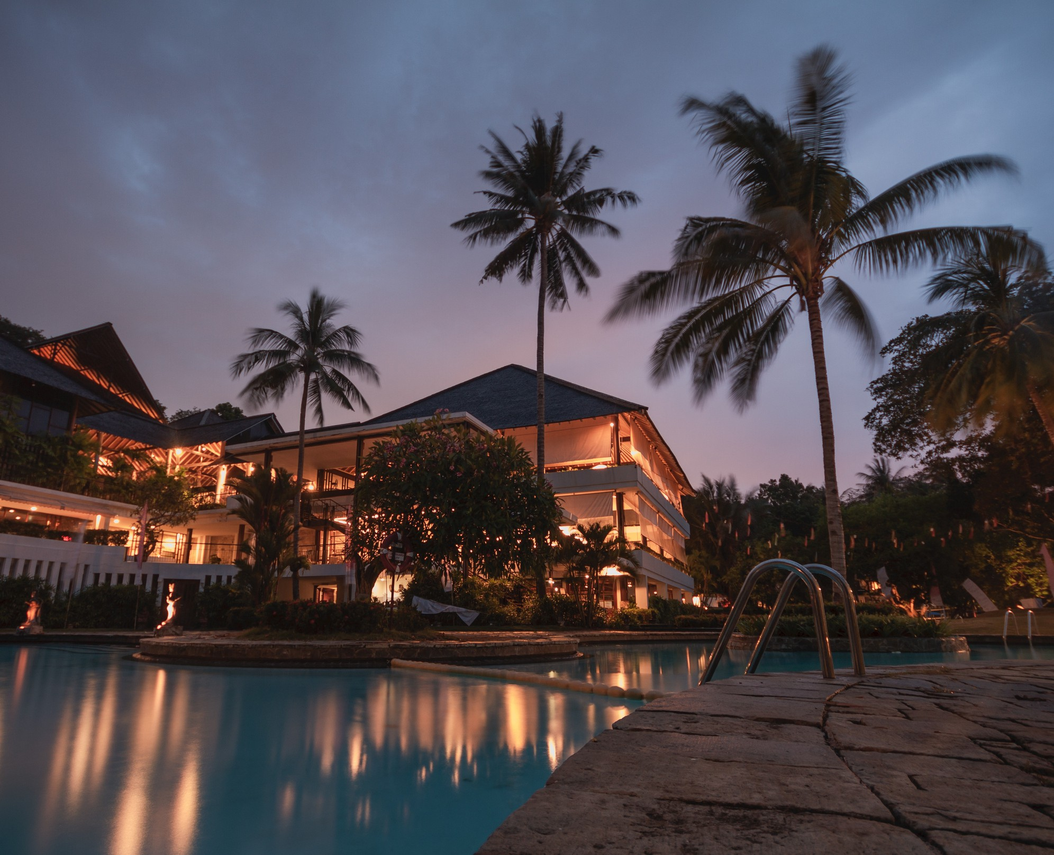
Home
About
Contact
AtliQ Grand
HOSPITALITY ANALYSIS
BY CHAITANYA DHAWADE

Slide 2
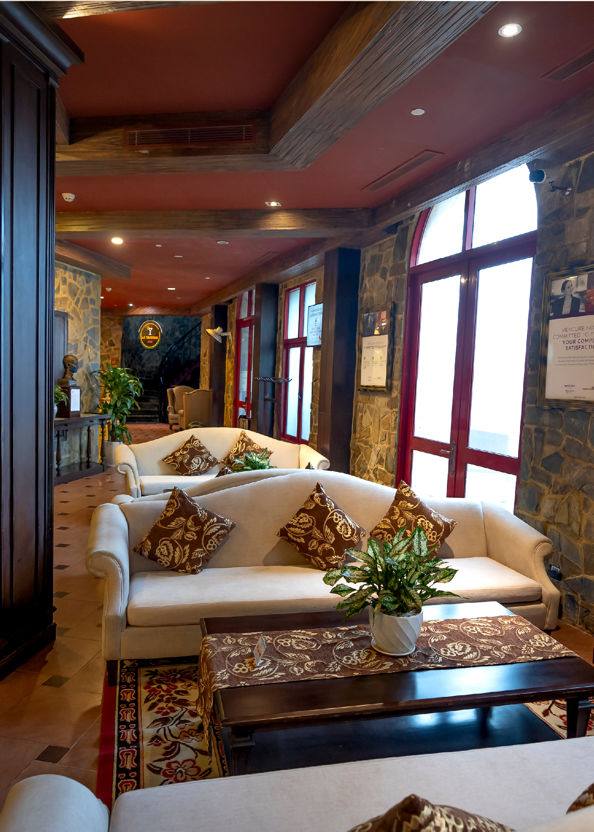





Table of Contents
01
Company Overview
02
Process Workflow
Problem Statement
03
04
Data Model
Key metrics
05
06
Observations and Insights
Dashboard
07
08
Strategic Recommendations

Slide 3
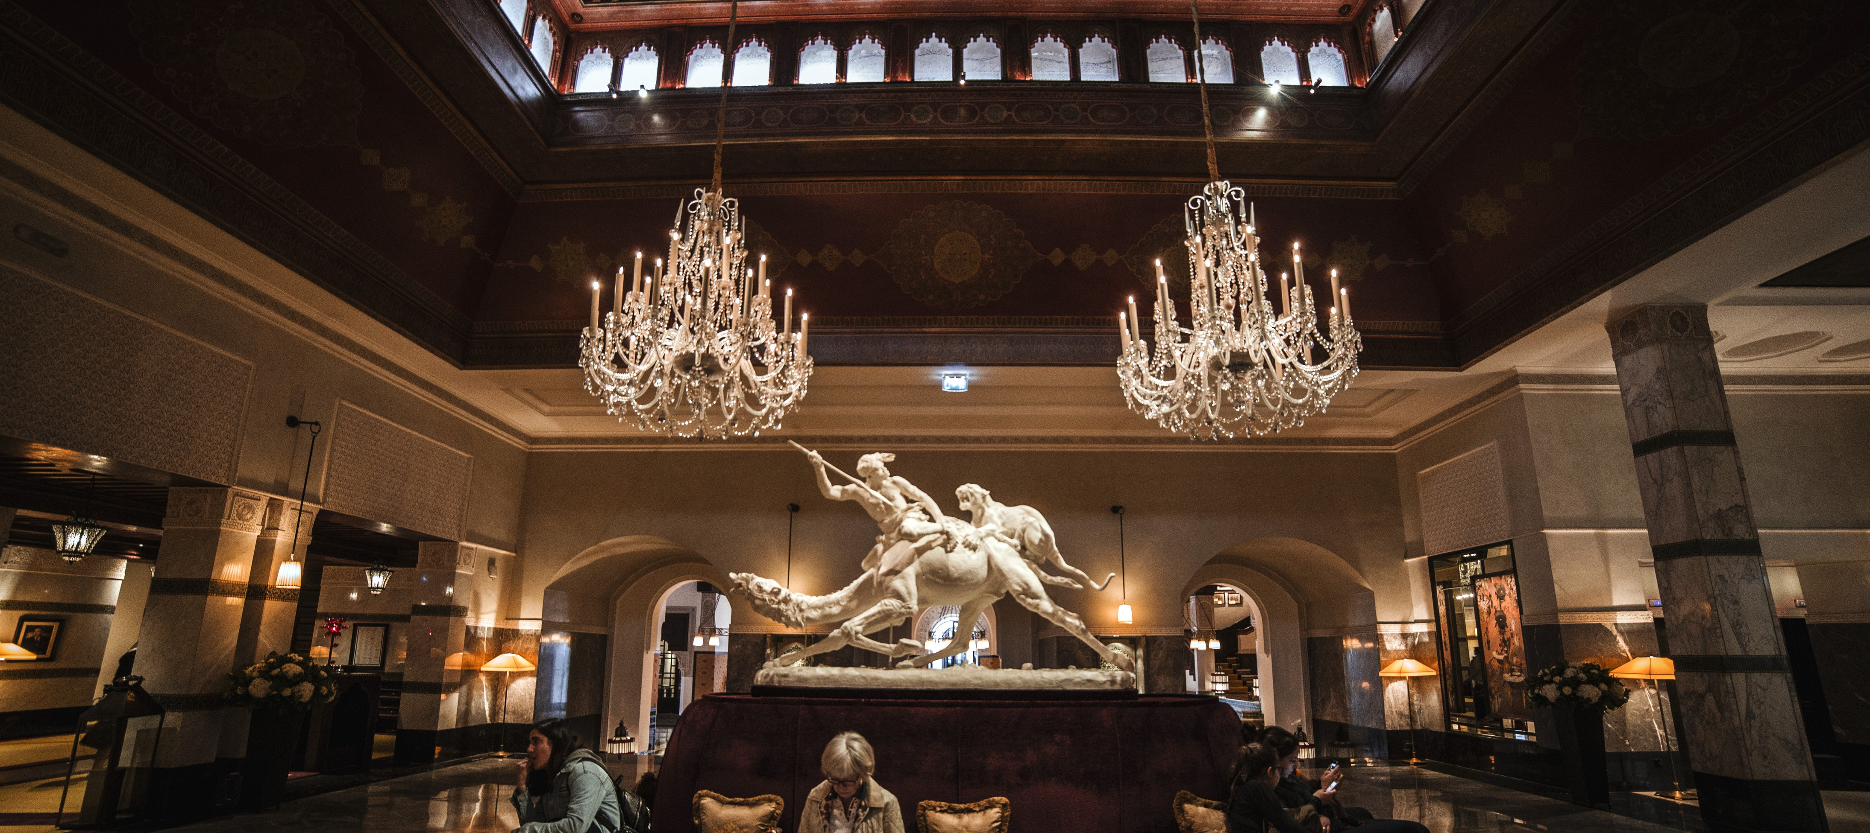
Welcome to AtliQ Grand

Slide 4
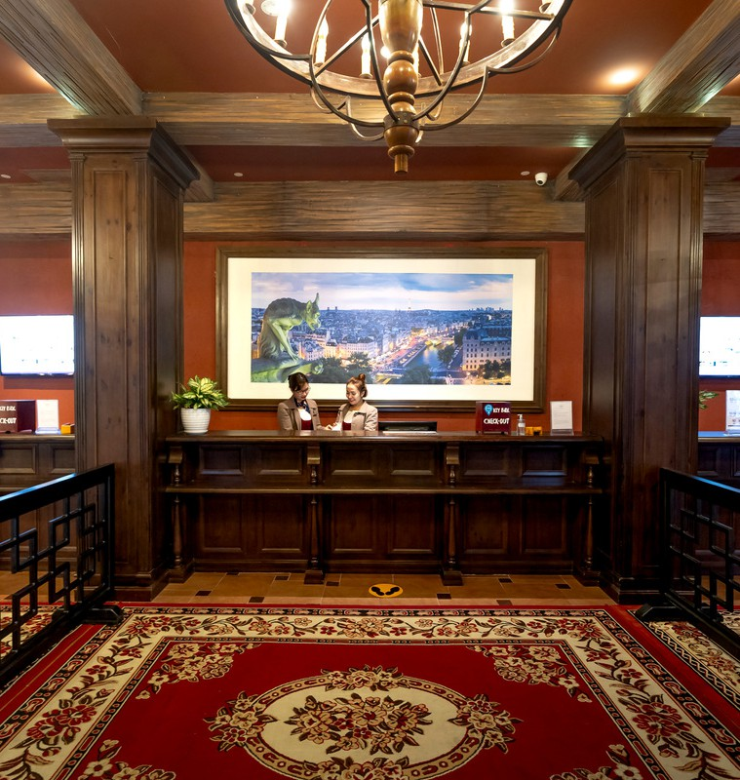

About Atliq Grand
AtliQ Grands owns multiple five-star hotels across India. They have been in the hospitality industry for the past 20 years. Due to strategic moves from other competitors and ineffective decision-making in management, AtliQ Grands are losing its market share and revenue in the luxury/business hotels category. As a strategic move, the managing director of AtliQ Grands wanted to incorporate “Business and Data Intelligence” in order to regain their market share and revenue. However, they do not have an in-house data analytics team to provide them with these insights.
Their revenue management team had decided to hire a 3rd party service provider to provide them insights from their historical data.

Slide 5


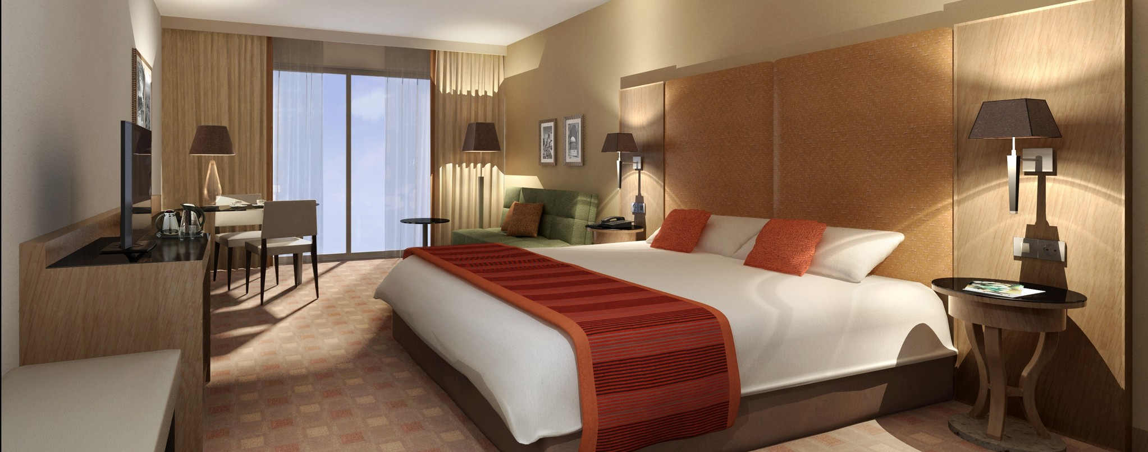
Problem Statement
Due to strategic actions by competitors and suboptimal decision-making within management, AtliQ Grands is experiencing a decline in market share and revenue in the luxury and business hotel sector.
To counteract this downturn, the managing director has decided to adopt a comprehensive "business and data intelligence" strategy. This approach aims to leverage data-driven insights and analytical tools to drive informed decision-making, optimize operations, and ultimately restore the hotel's competitive positioning and financial performance in the marketplace.

Slide 6

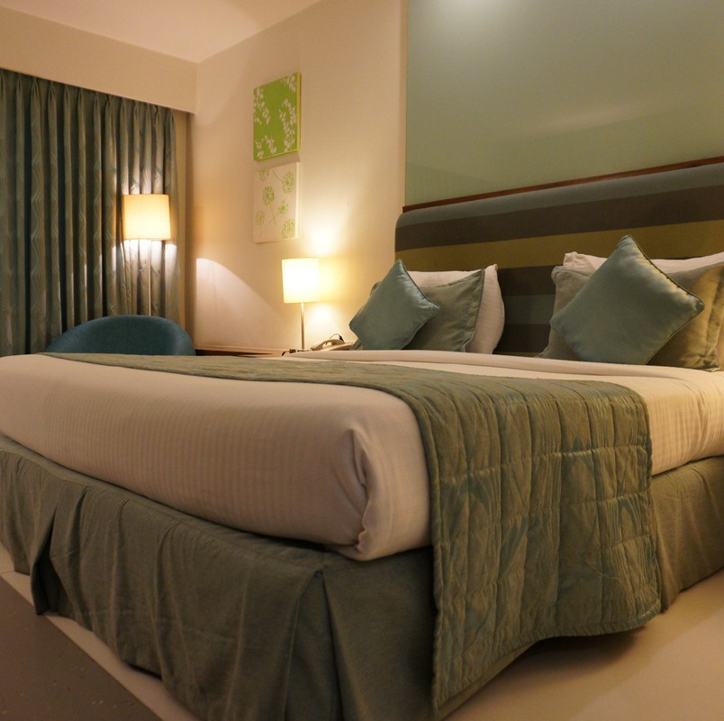

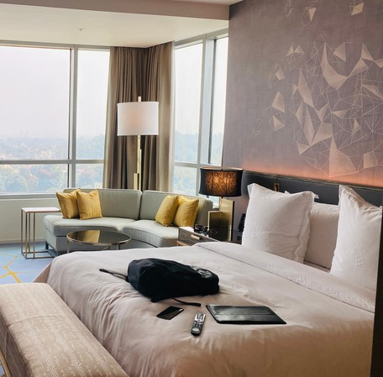
Process Workflow
Step 1
Data Import and Cleaning: Import data into Power BI from Excel, followed by initial data validation, cleaning, and transformation using Power Query to ensure data accuracy and consistency.
Step 2
Data Modeling and Structuring: Develop a robust data model by defining relationships between tables and structuring the data to support insightful analysis.
Step 3
Measure Development with DAX: Utilize DAX (Data Analysis Expressions) to create calculated measures and key performance indicators (KPIs) that align with the business objectives and analytical needs.
Step 4
Data Validation and Quality Assurance: Conduct a thorough validation process to ensure that all data transformations and calculations are accurate and reliable.
Step 5
Dashboard Design and Visualization: Design and build an interactive dashboard using Power BI’s visualization capabilities, selecting appropriate visual elements to effectively communicate insights and support data-driven decision-making.
Visualization Tool: Power BI
Data Source: Excel

Slide 7

Key Metrics
ADR (average daily rating): The average payment for rooms sold in a given time period.
DBRN (Daily Booking Room Nights): Average number of rooms are booked for a day considering a time period.
DSRN (Daily Sellable Room Nights): Average number of rooms are ready to sell for a day considering a time period.
DURN (Daily Utilized Room Nights): Average number of rooms are successfully utilized by customers for a day considering a time period.
RevPAR (Revenue Per Available Room): RevPAR represents the revenue generated per available room, even whether they are occupied or not.
Realization%: It is nothing but the successful "checked out" percentage over all bookings happened.
Occupancy%: Occupancy means total successful bookings happened to the total rooms available (capacity).

Slide 8

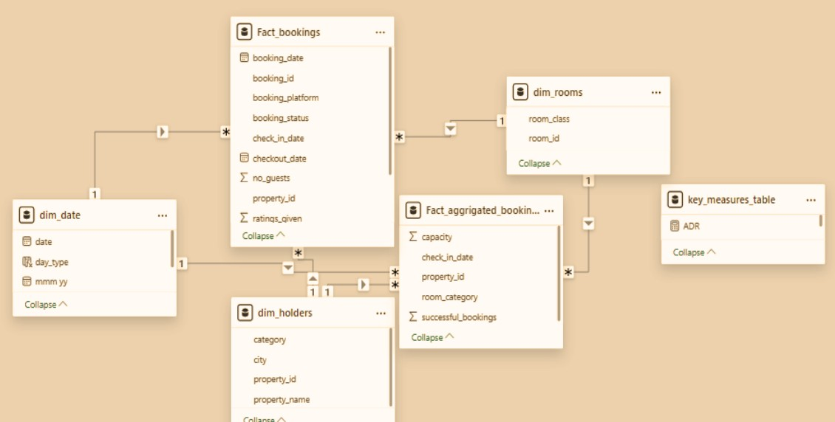
Data Model

Slide 9
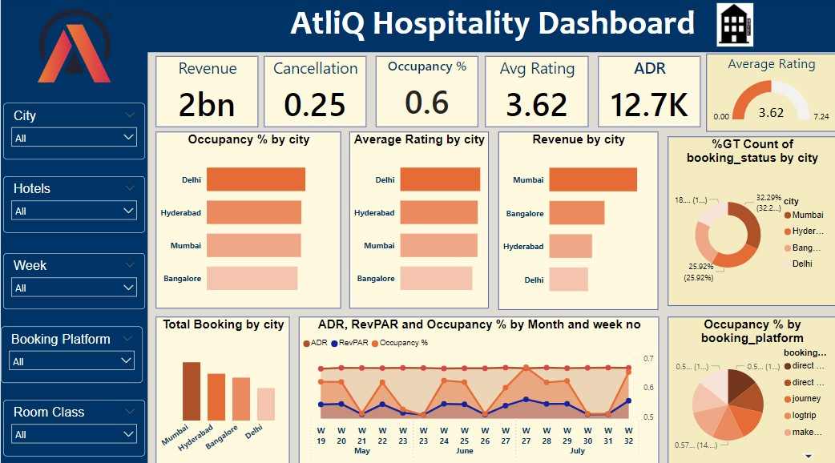
1. Overall Analysis

Slide 10
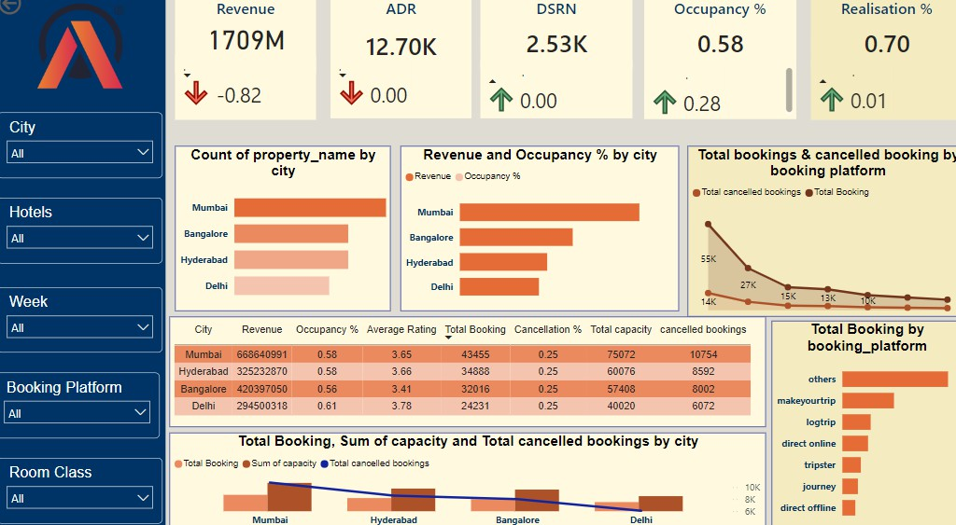
2. Revenue Analysis

Slide 11
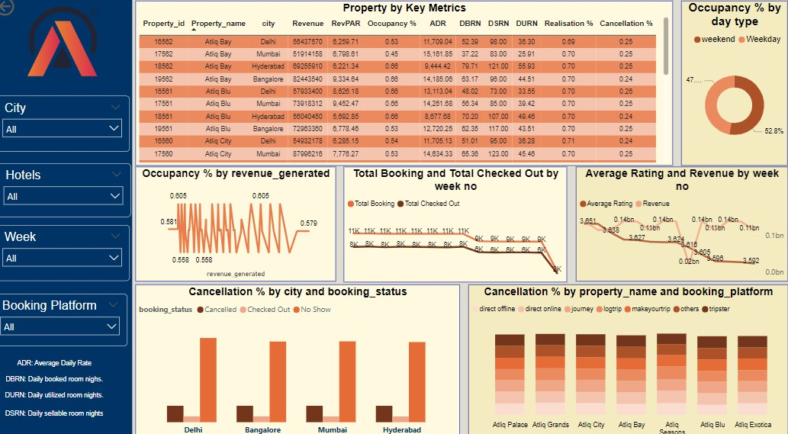
3.Booking Analysis

Slide 12


Observations and Insights
Revenue Peaks and Patterns
Weekend Revenue Surges:
Revenue peaks during weekends, with significantly higher RevPAR (Revenue Per Available Room) and occupancy rates. This pattern suggests the need to optimize pricing and promotional strategies during weekends to capitalize on high demand.
City-Wise Performance:
Mumbai leads in revenue generation with 661 million. Delhi: Records the highest occupancy rate but the lowest revenue at 291 million, indicating the potential for revenue enhancement through targeted strategies in high-occupancy but lower-revenue cities.
Pricing Strategy and Revenue Insights:
Lack of dynamic pricing:
Current pricing strategies are static, with minimal week-over-week and month-over-month revenue changes for both business and luxury segments. RevPAR changes closely mirror changes in occupancy%, and ADR (average daily rate) remains unchanged, indicating no dynamic pricing adjustments based on demand. This highlights missed opportunities during peak seasons (e.g., May, June, July).
Static Room Rates Across Weekdays and Weekends:
There is no significant rate variation between weekdays and weekends, which represents a missed opportunity to optimize revenue by adjusting rates according to demand fluctuations.

Slide 13



3. Utility Cost Management:
Rising utility costs necessitate energy-saving initiatives and sustainable practices to reduce
operational expenses and improve overall profitability.
4. Direct Booking Channel Optimization:
Direct bookings achieve the highest realization percentage, emphasizing the need to director promote channels (e.g., the hotel's website) to minimize commission fees and increase profit margins.
5. Service Quality and Financial Performance Correlation:
Hotels with higher average ratings also show higher occupancy rates and revenues. Conversely, hotels with low ratings exhibit lower occupancy and revenue, indicating the need for a root cause analysis to identify issues such as inadequate room service, discrepancies between service offerings and advertisements, or other factors impacting guest satisfaction.

Slide 14

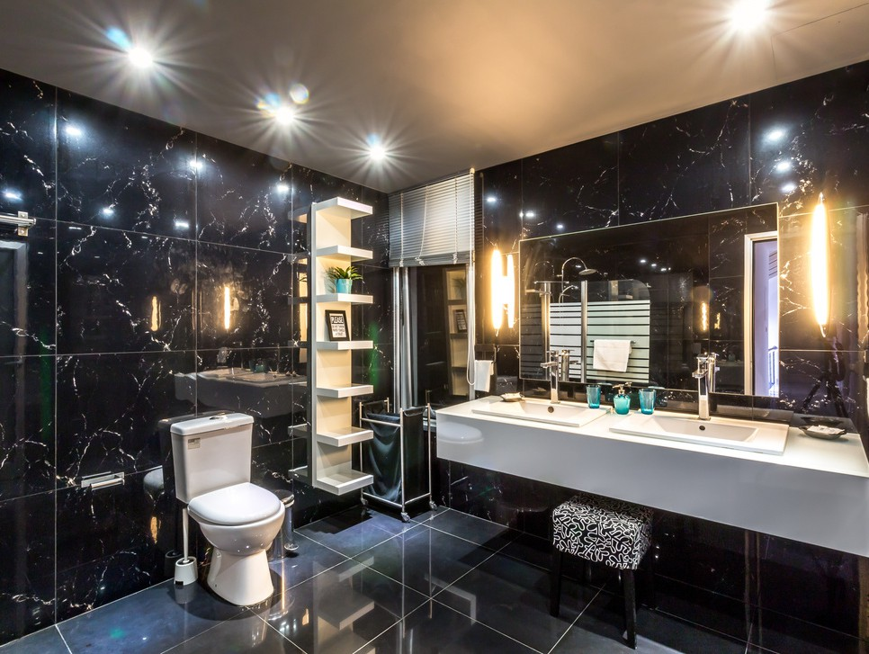
6. Room Class Performance:
Elite Room Class:
Consistently performs best across all four cities, generating the highest revenue (554M).
Standard and Presidential Rooms:
Underperform in revenue and ratings, necessitating an investigation into potential causes such as customer preferences, service quality, or pricing strategy to implement corrective measures.
Booking Platform Performance:
.“Make Your Trip” emerges as the top revenue-generating online platform. Other platforms may underperform due to outdated information, inconsistent pricing, or inadequate promotional strategies.
Direct Offline Bookings:
Generate the highest ADR, while direct online bookings generate the lowest. Optimizing direct online bookings could improve profitability, avoiding platform fees.
Key Financial metrics:
Total Revenue: 1.69 billion Overall Occupancy Rate: 57.79% Overall RevPAR: 7,336.56
Overall ADR: 12,695.76
Cancellation Rate: 24.8%
Average Rating: 3.62

Slide 15

Strategic Recommendations
Adopt a Dynamic, Demand-Based Pricing Strategy:
Implement a pricing model that adjusts rates based on demand. Increase prices during peak seasons (e.g., summer holidays) and reduce them during off-peak periods to maximize revenue and align with market trends. Introduce rate variation between weekdays and weekends to better capitalize on higher weekend demand.
Maintain Rate Parity Across Channels:
Ensure consistent room rates across all online booking platforms and the hotel’s website. Provide special promotions, such as discount coupons or complementary services, to boost bookings and enhance customer satisfaction.
Leverage Occupancy-Based Pricing::
Adjust pricing dynamically based on occupancy levels to optimize revenue throughout the year. For example, lower rates during periods of low occupancy and higher rates during high occupancy periods.

Slide 16
4. Introduce customer loyalty and retention programs:
Offer discounts for frequent business travelers to encourage repeat bookings and build customer loyalty.
Implement Length of Stay (LOS) discounts to incentivize extended stays, thereby increasing overall occupancy rates and customer retention.
.
Enhance Service Quality to Boost Ratings and Financial Performance:
Focus on maintaining and improving service standards to directly impact ratings, occupancy, and revenue positively. Address factors affecting low ratings, such as service discrepancies, to enhance guest satisfaction.
Optimize Room Class Performance:
Investigate the underperformance of "standard" and "presidential" rooms to understand the causes, whether related to pricing, amenities, or market positioning. Implement targeted strategies to boost their appeal and revenue generation.
Revise Booking Platform Strategy:
Optimize performance across different booking channels by ensuring updated and consistent information, competitive pricing, and effective promotional strategies.
Enhance direct online booking capabilities to reduce reliance on third-party platforms and increase profitability.

Slide 17
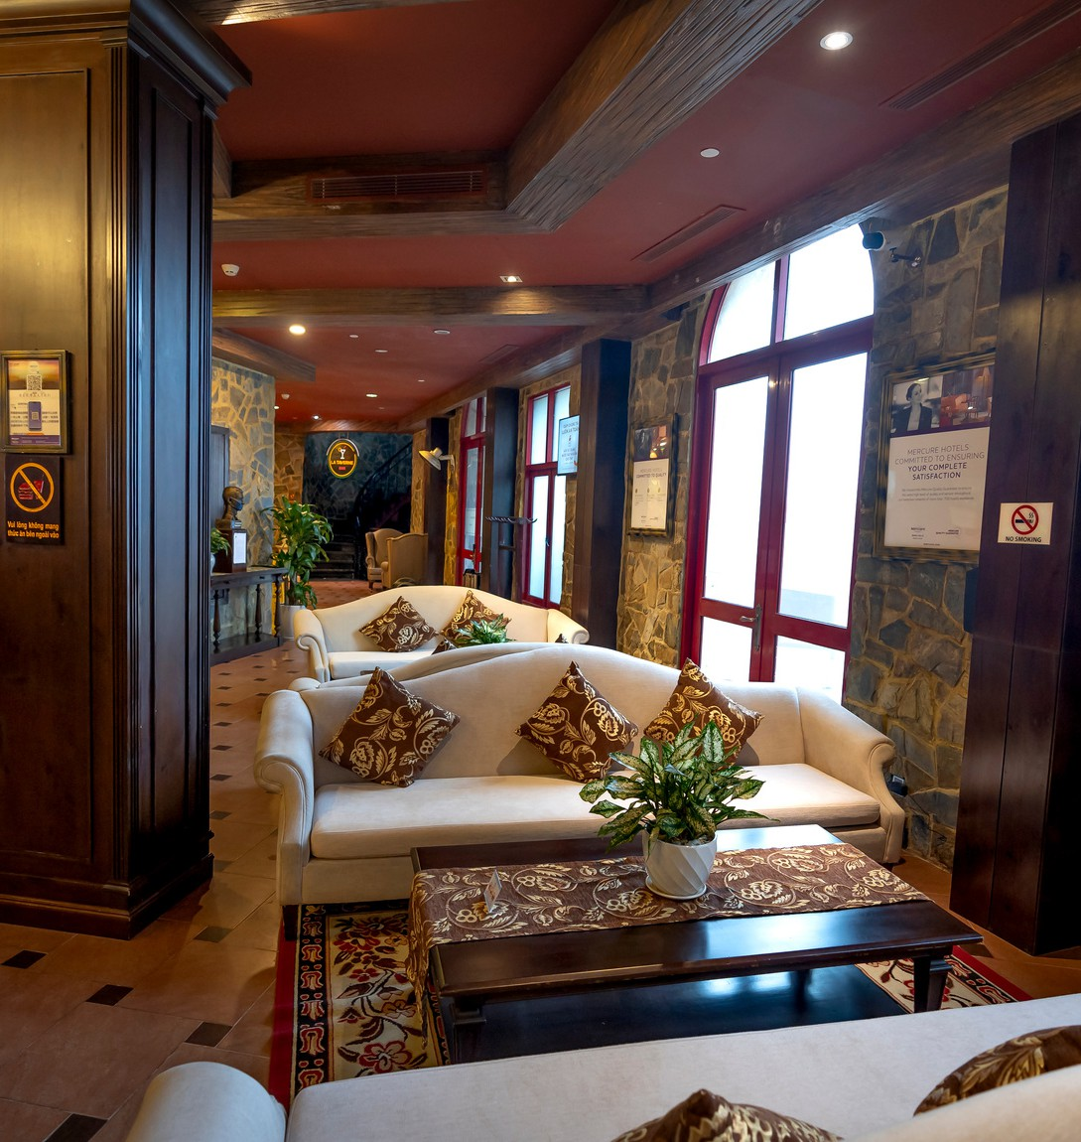
Home
About
Contact
Thank You
F O R Y O U R A T T E N T I O N

